Slide 1
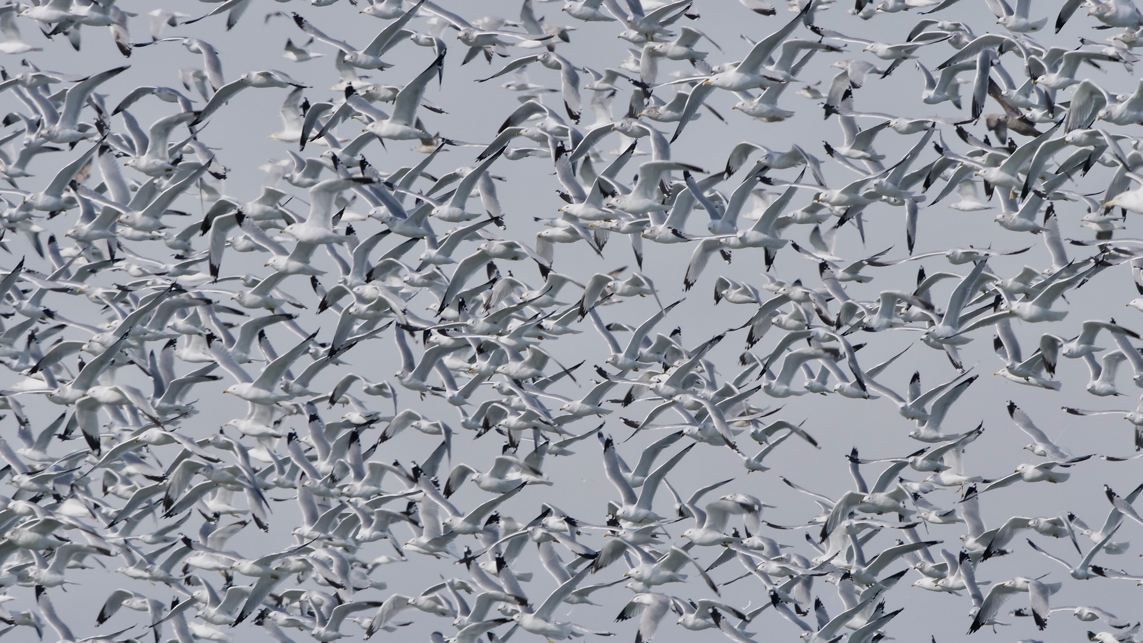
Gulls of Cleveland

Slide 2
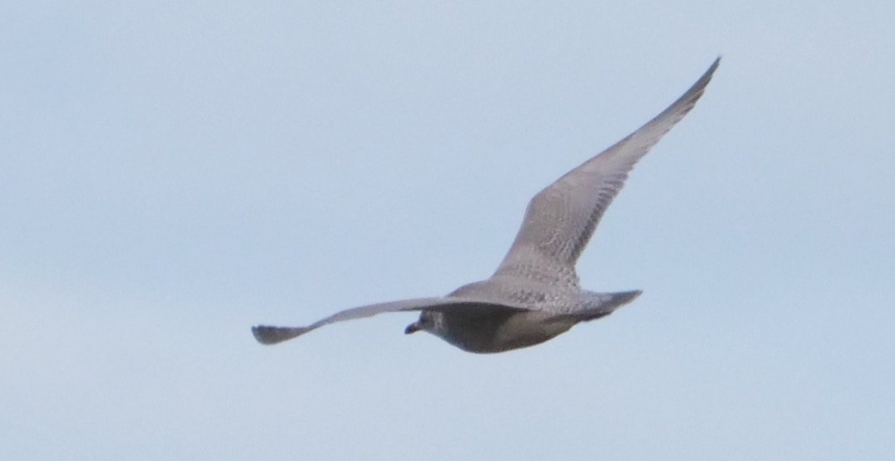
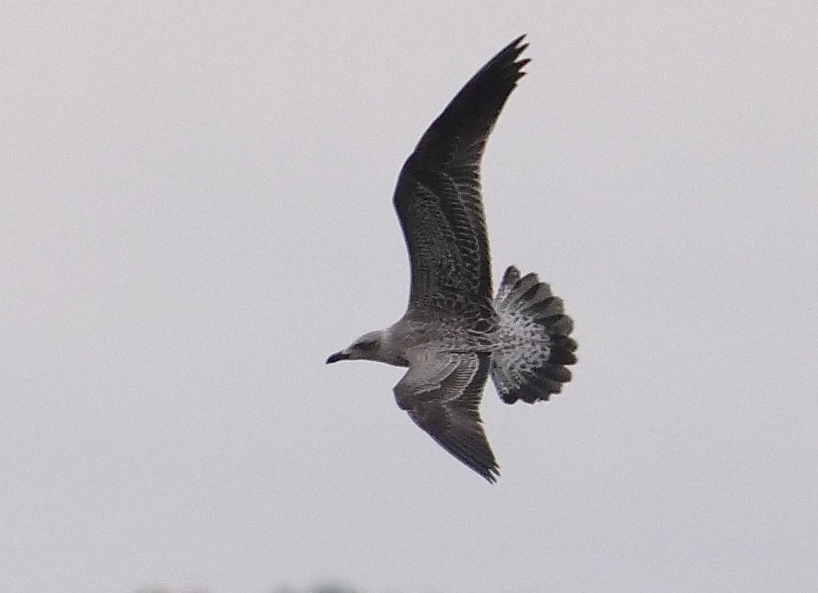

Slide 3
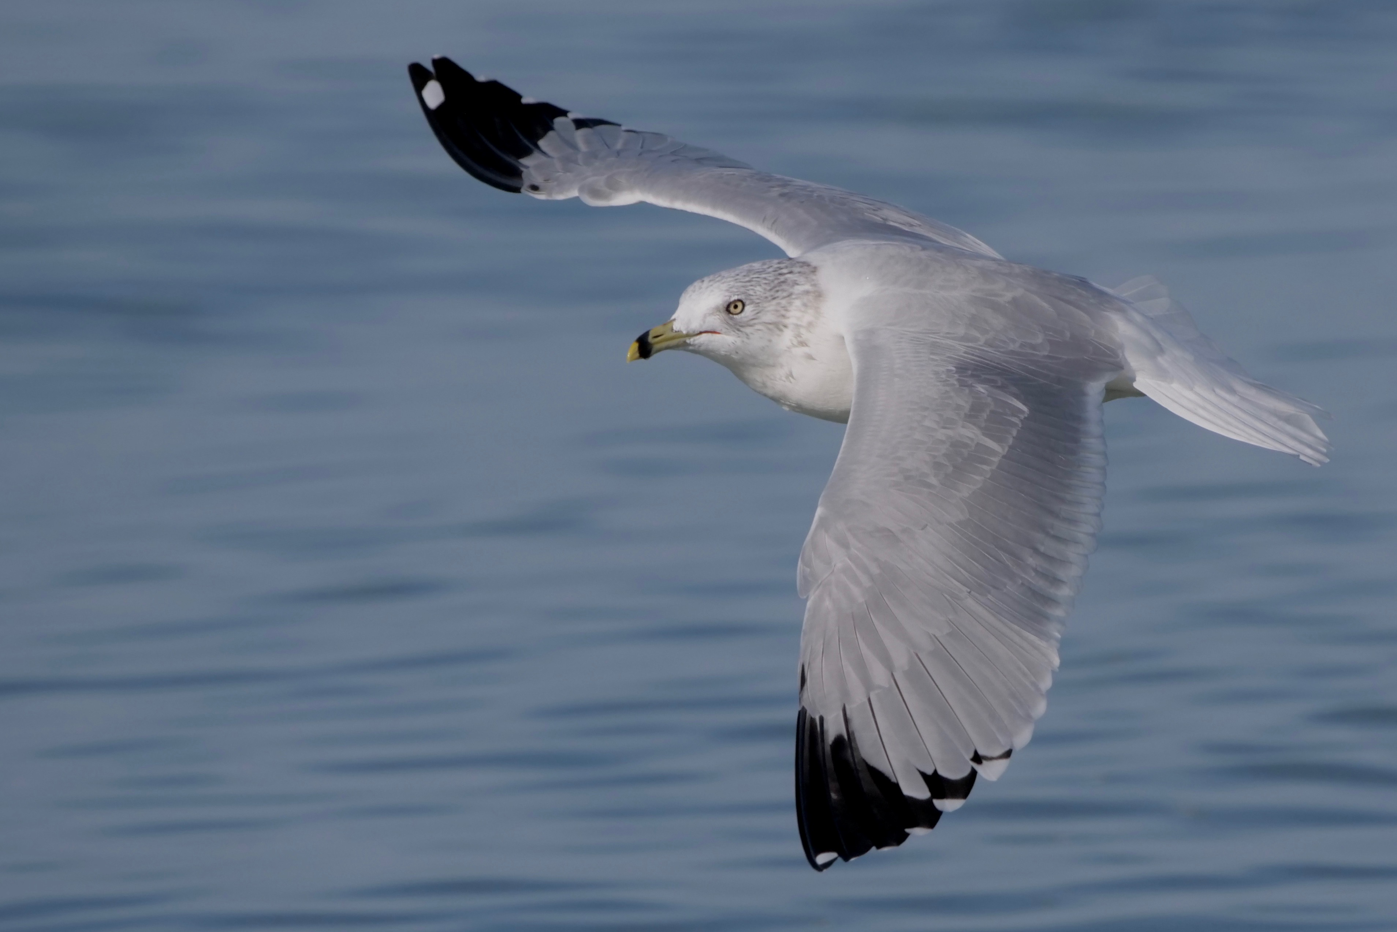
Ring-billed Gull

Slide 4
Ring-billed Gull
ringed bill, pale eye
outer primary spot

Slide 5
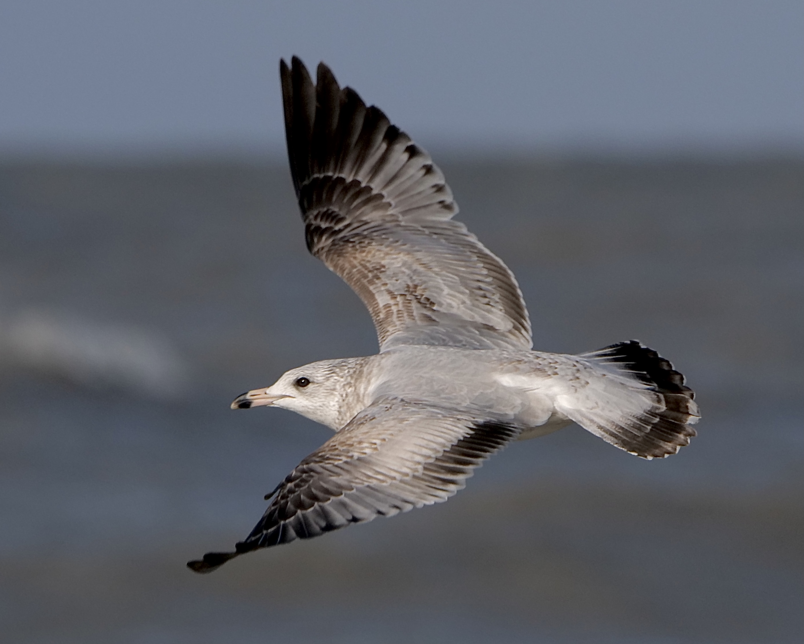
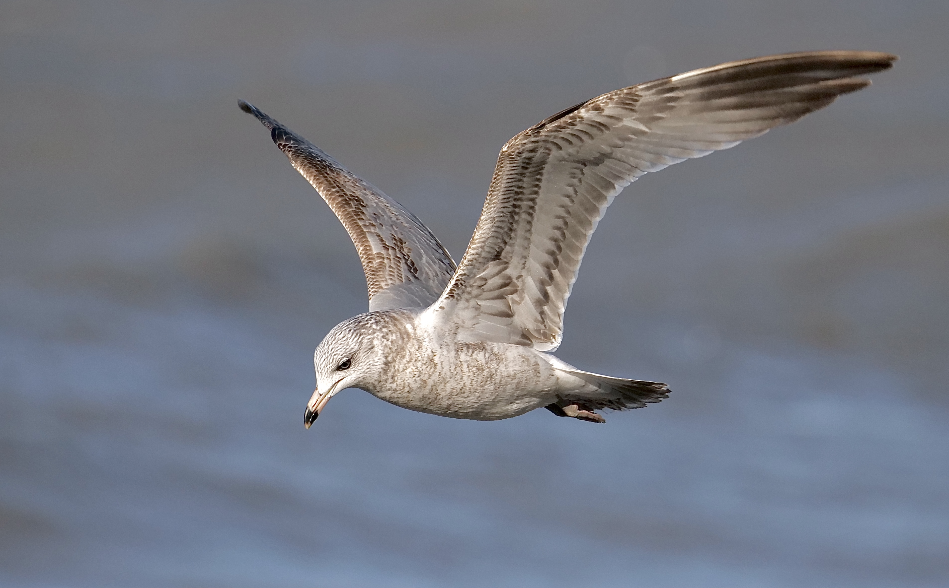
Ring-billed Gull
(1st cycle)

Slide 6
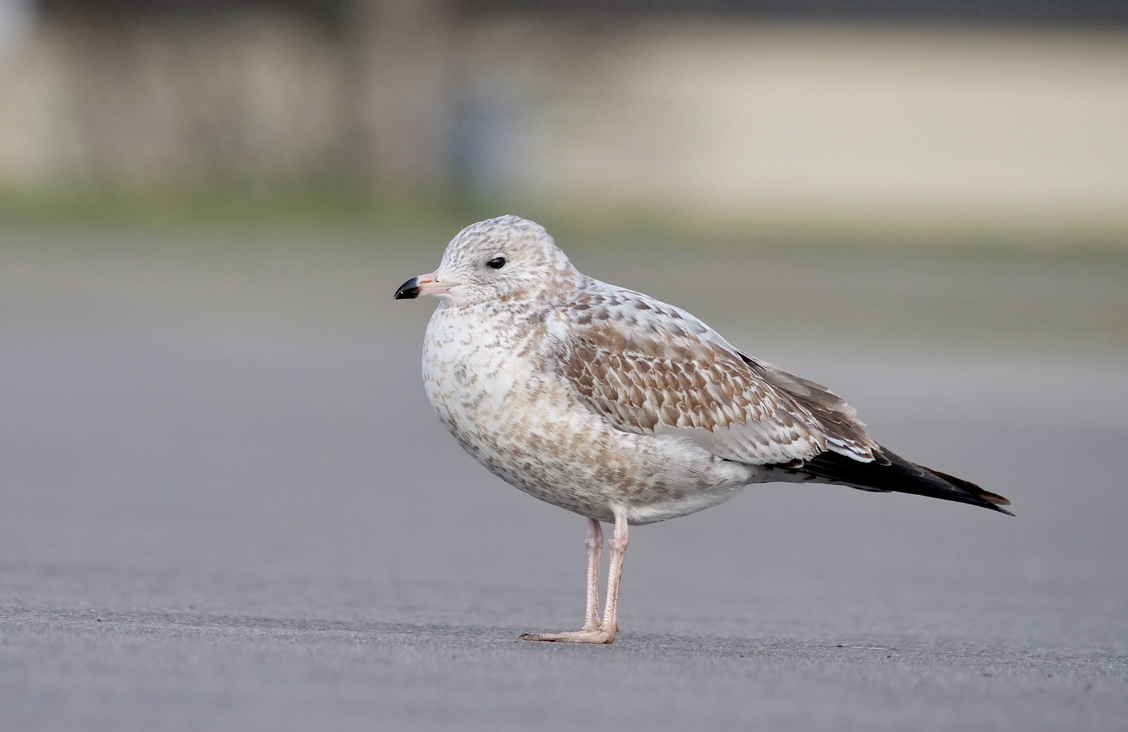
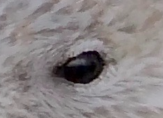
gray mantle and wing coverts
dark eye
bicolored pink/black bill
pinkish legs (yellow on adults)

Slide 7
Ring-billed Gull
(2nd cycle breeding)
solid black wingtips and tailband (lost in adult plumage
adult bill pattern
clean white head in breeding plumage
yellowish legs

Slide 8
Herring Gull
Herring Gull

Slide 9
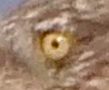
Herring Gull
Herring Gull
pale eye
outer primary spots
pink feet
red lower mandible spot

Slide 10
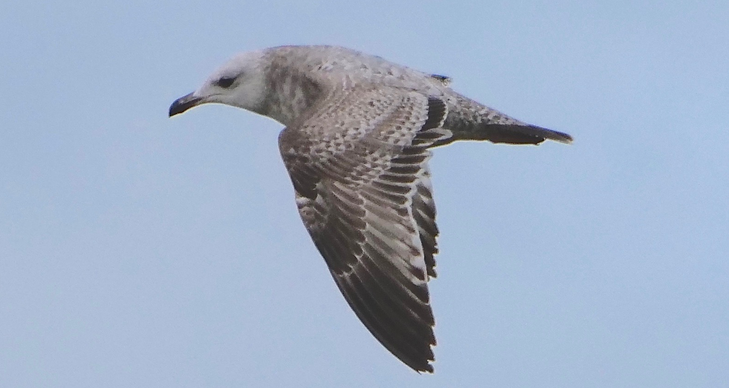
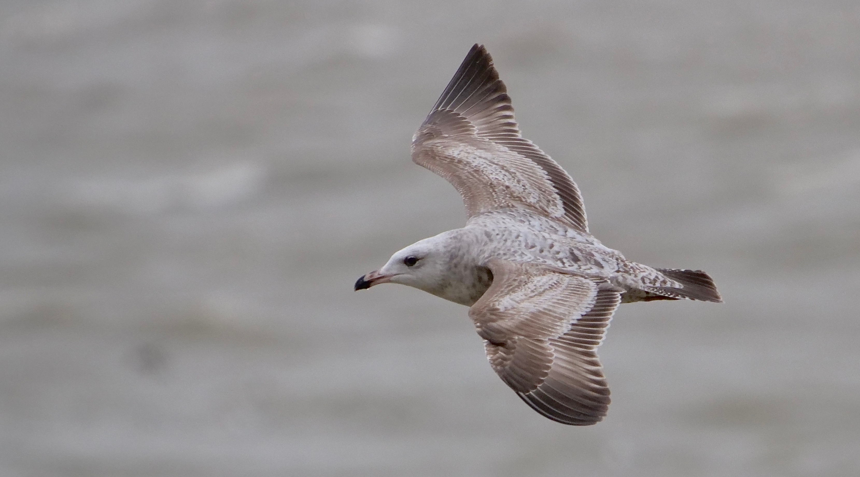
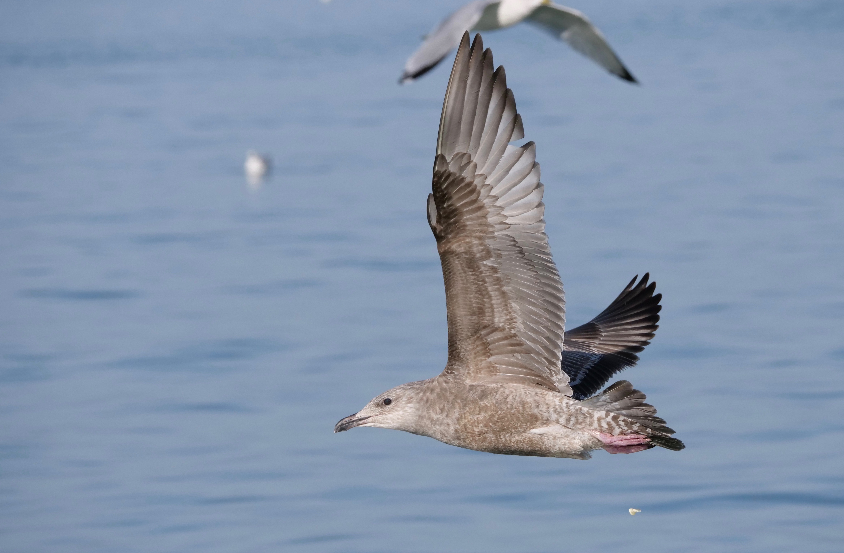

Slide 12
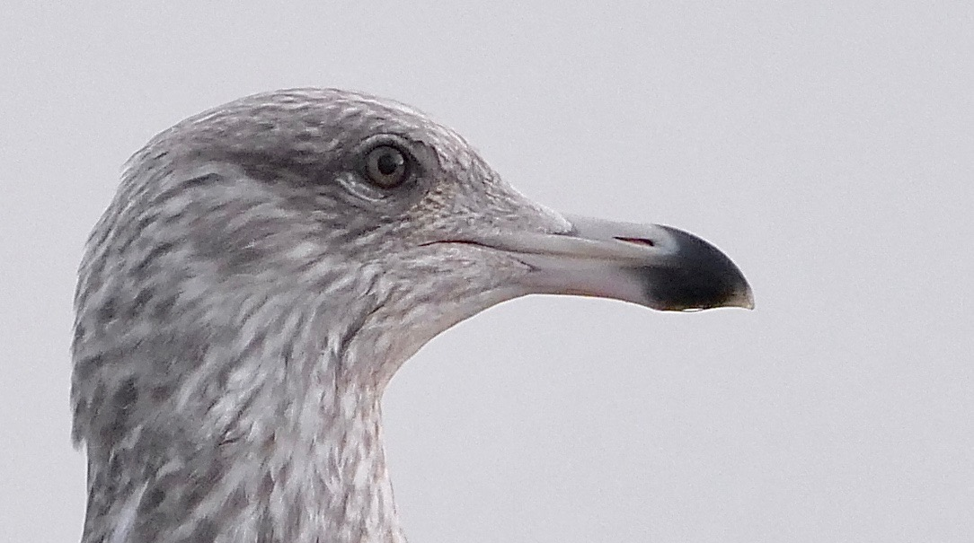

Slide 13
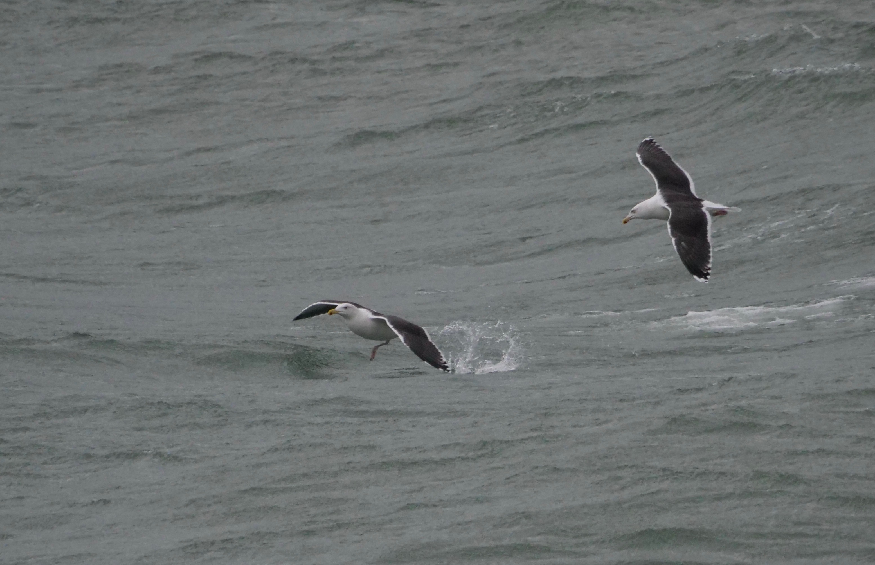
Great Black-backed Gull

Slide 14
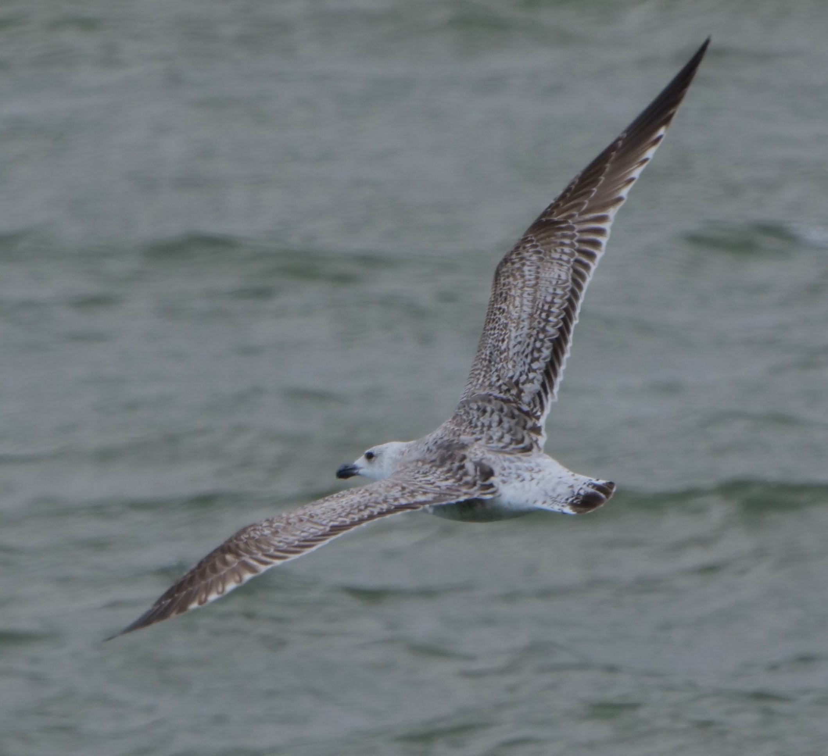
1st cycle (L) and 2nd cycle (R)

Slide 15
high contrast between pale head and tail, dark mantle and upperwing
massive head and bill
broad, blunt-tipped wings

Slide 17
Lesser Black-backed Gull

Slide 18
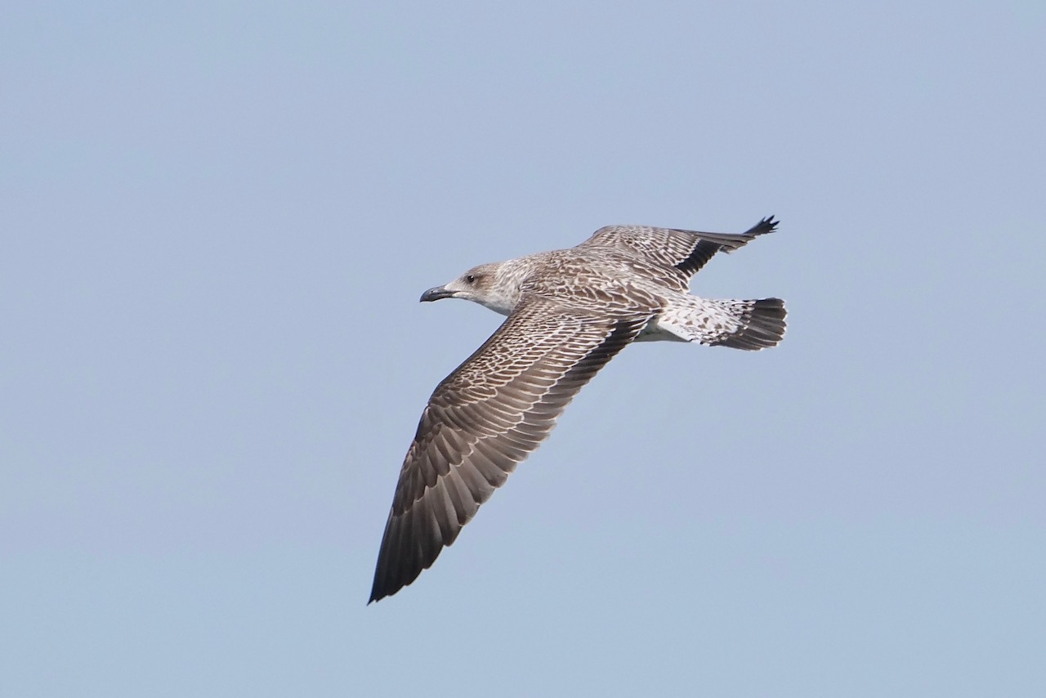
1st cycle (L) and adult breeding (R)

Slide 19
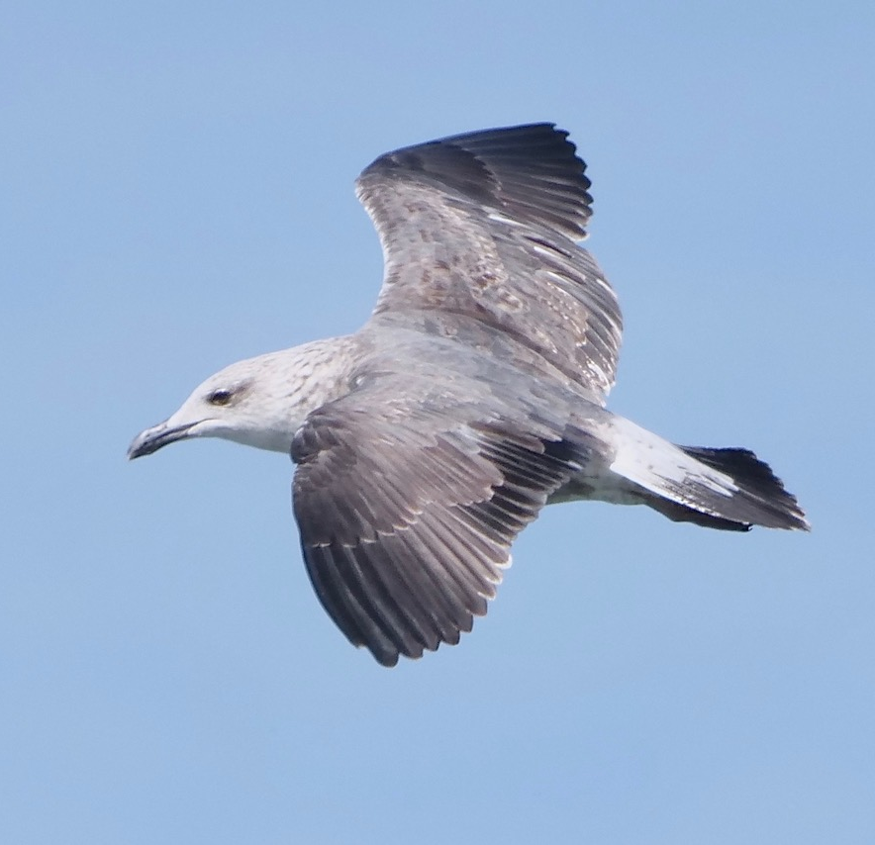
Various ages

Slide 20
slender, all-black bill with gently sloped forehead
white ”rump” strongly contrasting with dark back and thick black tailband
Intricate patterning on
upperwing coverts and mantle
dark-handed wing with broad black trailing edge, proportionally narrow and long wing

Slide 25
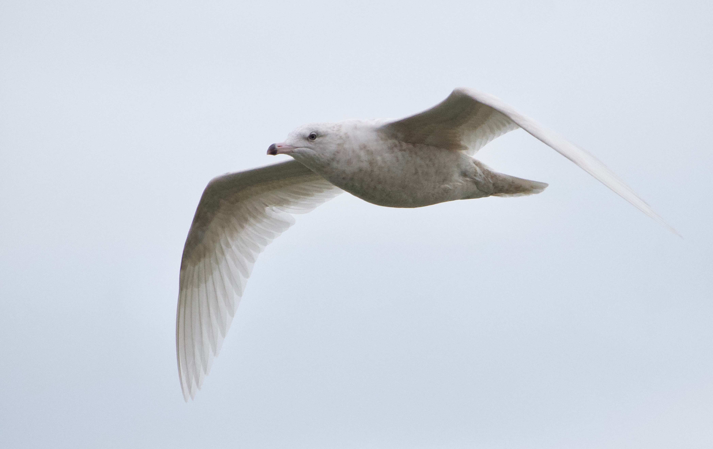
Glaucous Gull

Slide 26
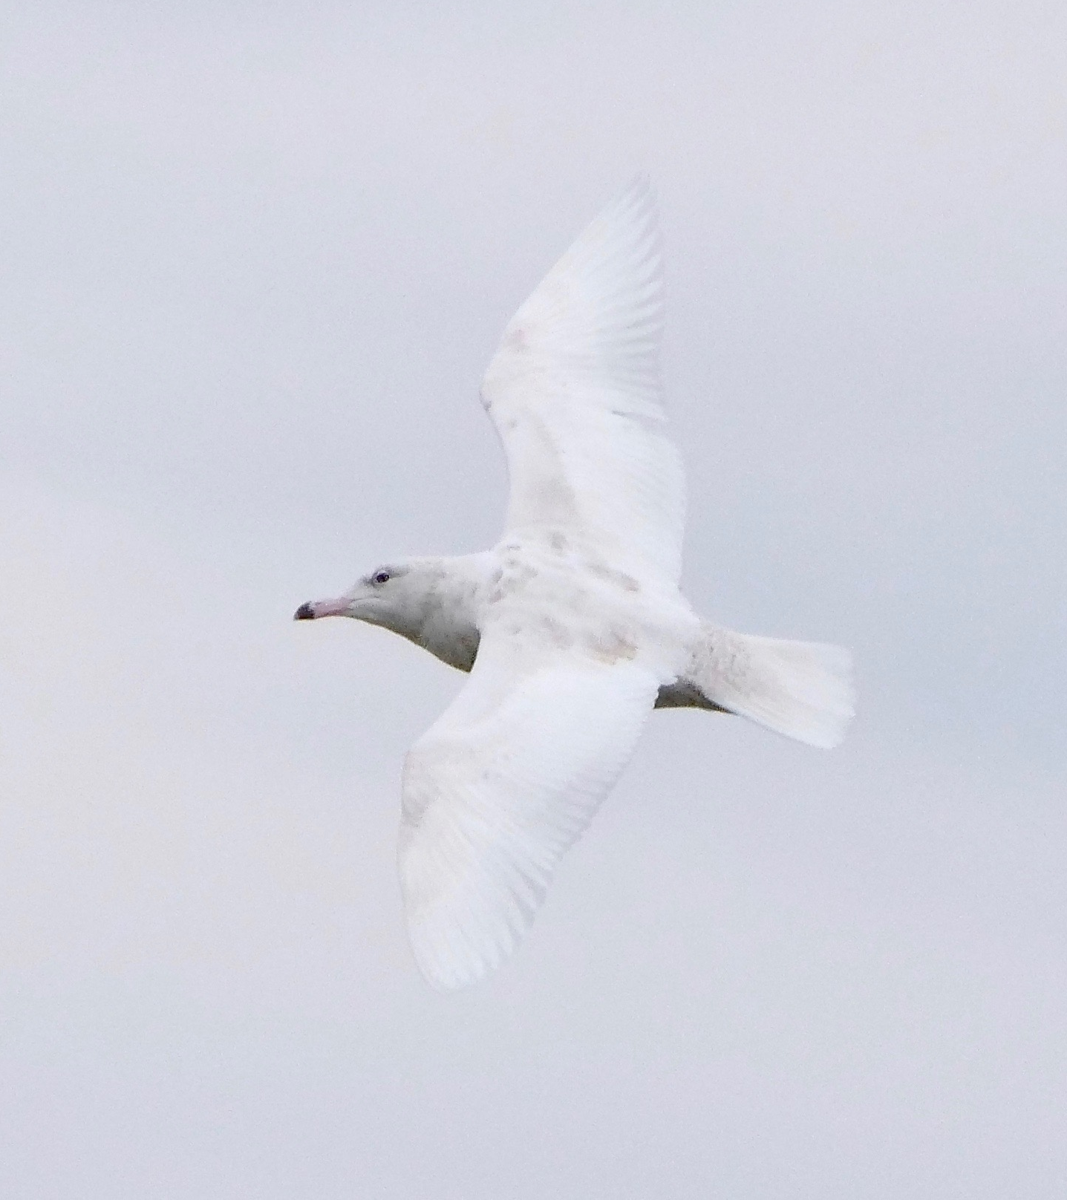

Slide 27
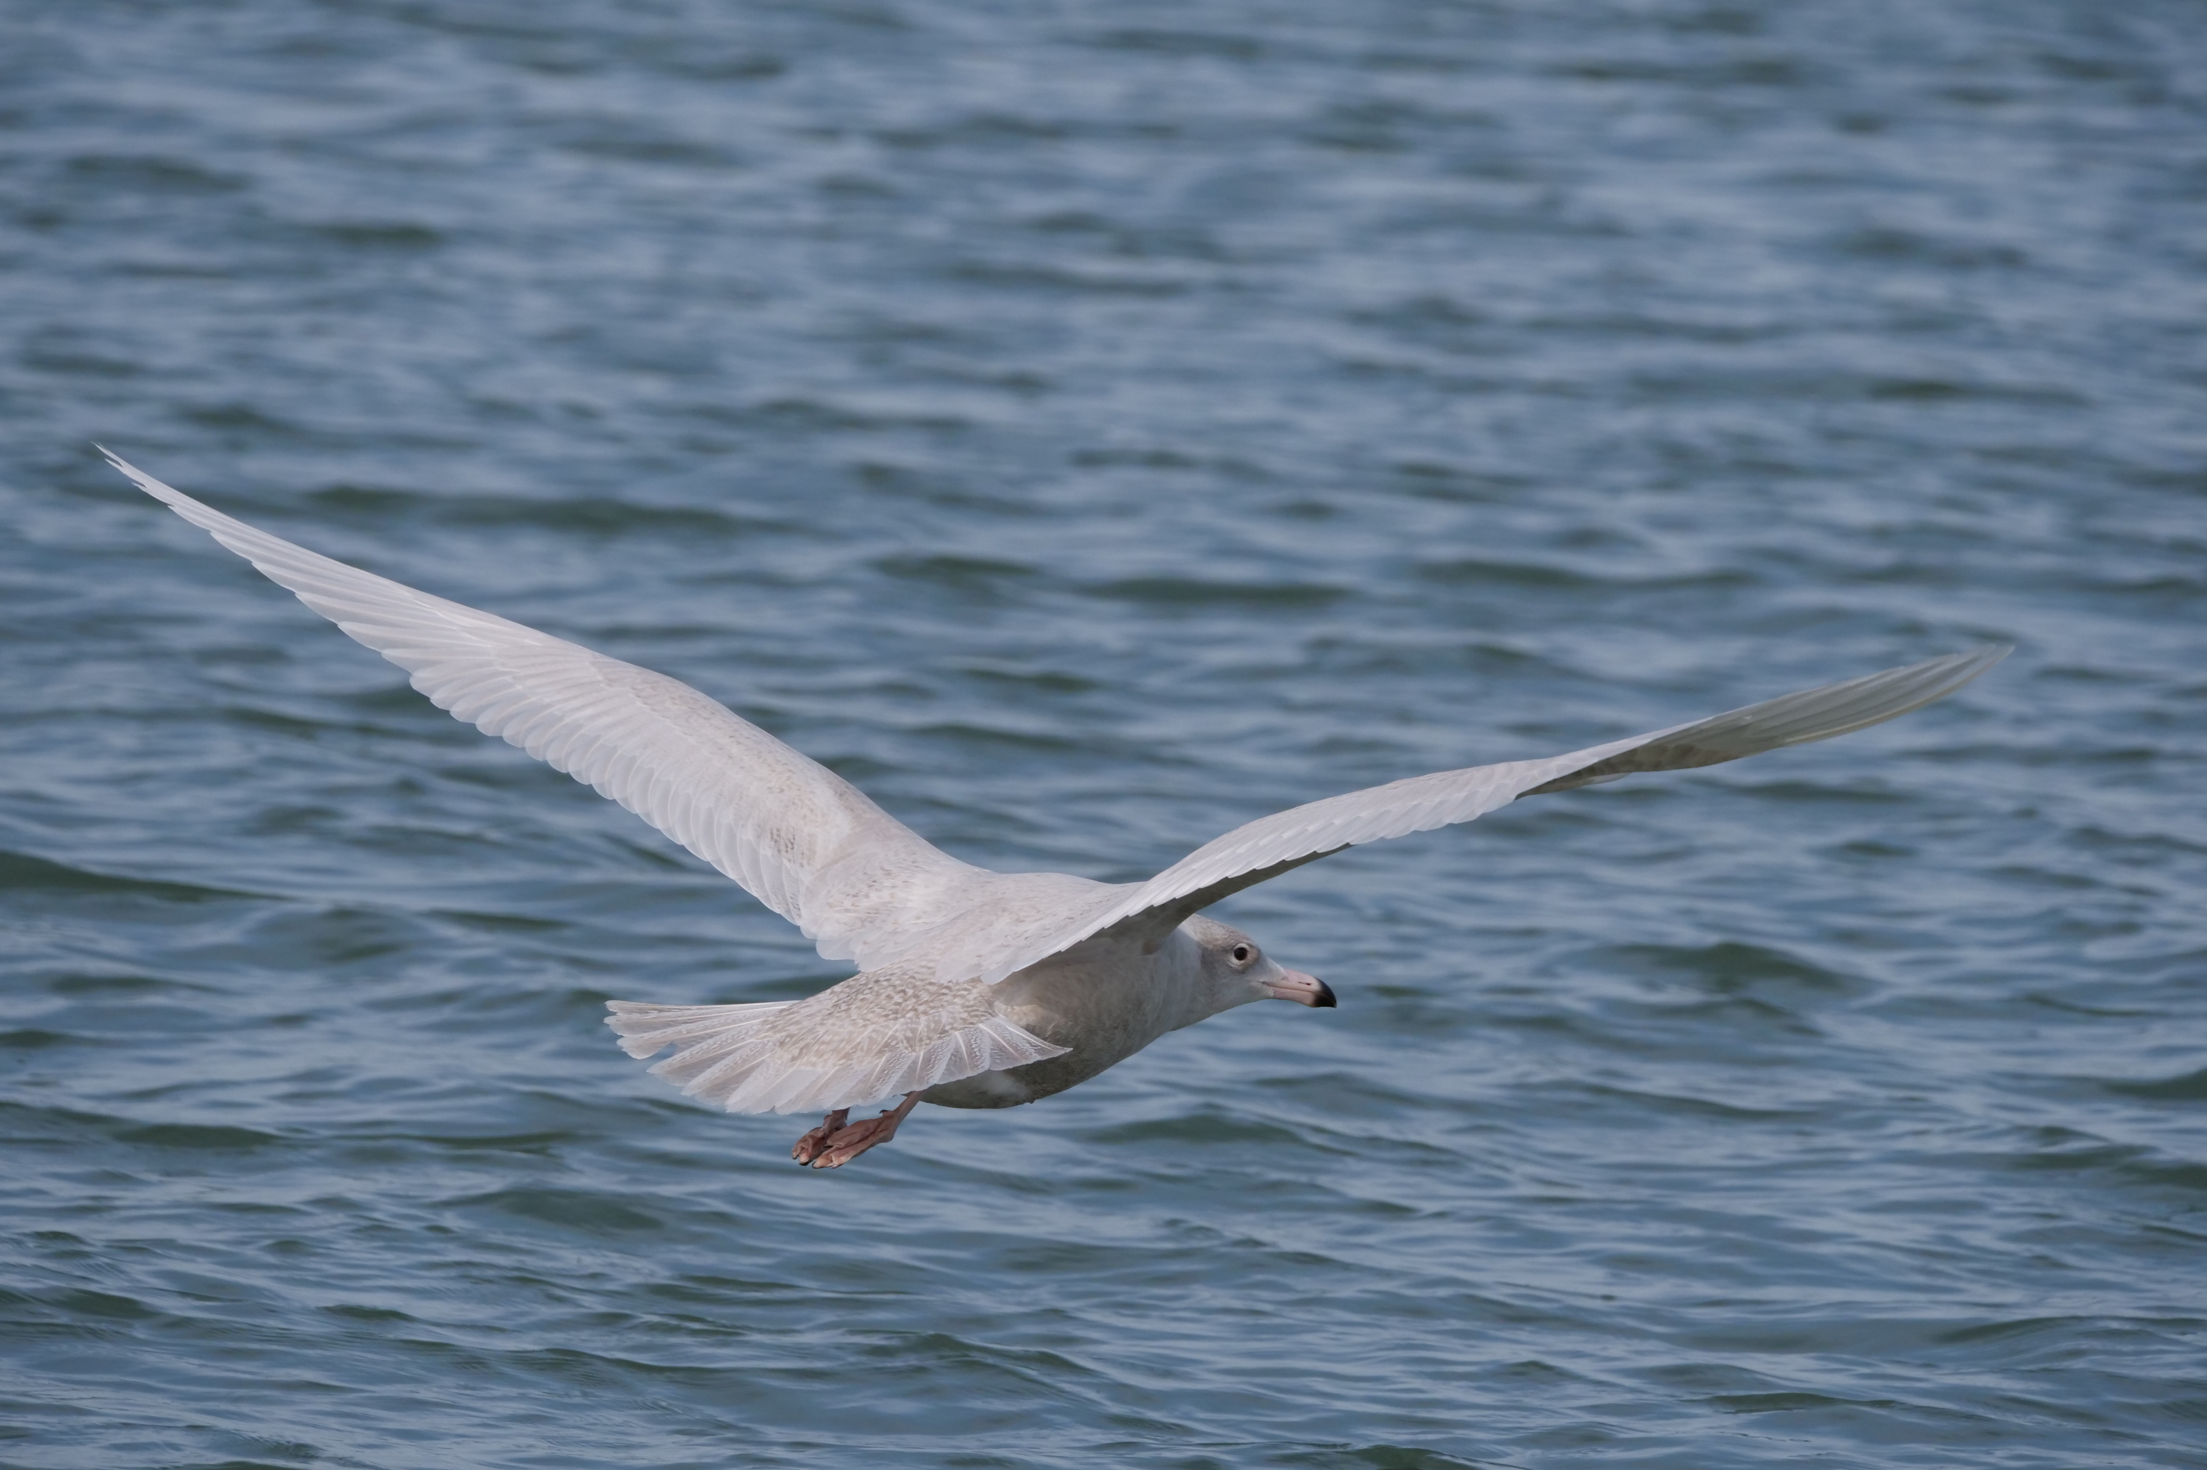
1st cyc Iceland Gull (L) and 1st cyc Glaucous Gull (R)

Slide 28
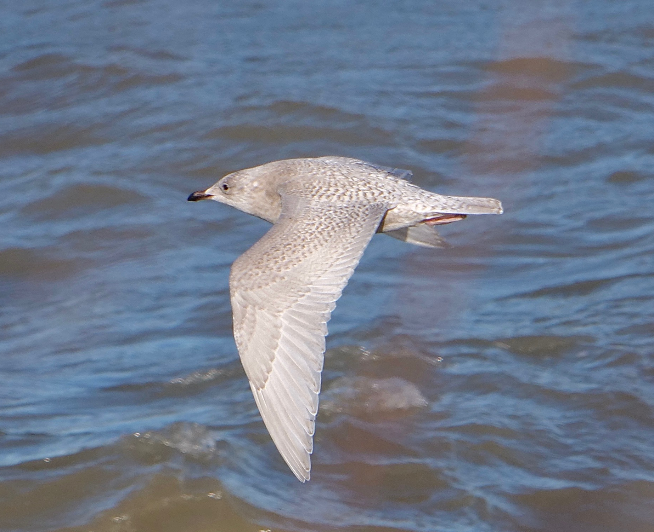
Iceland Gull (L) and Glaucous Gull (R)

Slide 29
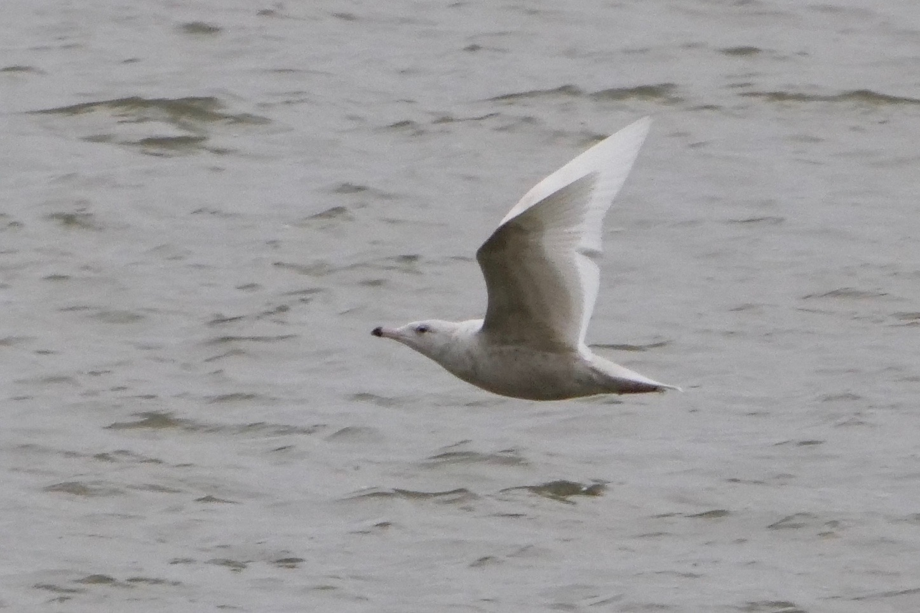
Iceland Gull (L) and Glaucous Gull (R)

Slide 30
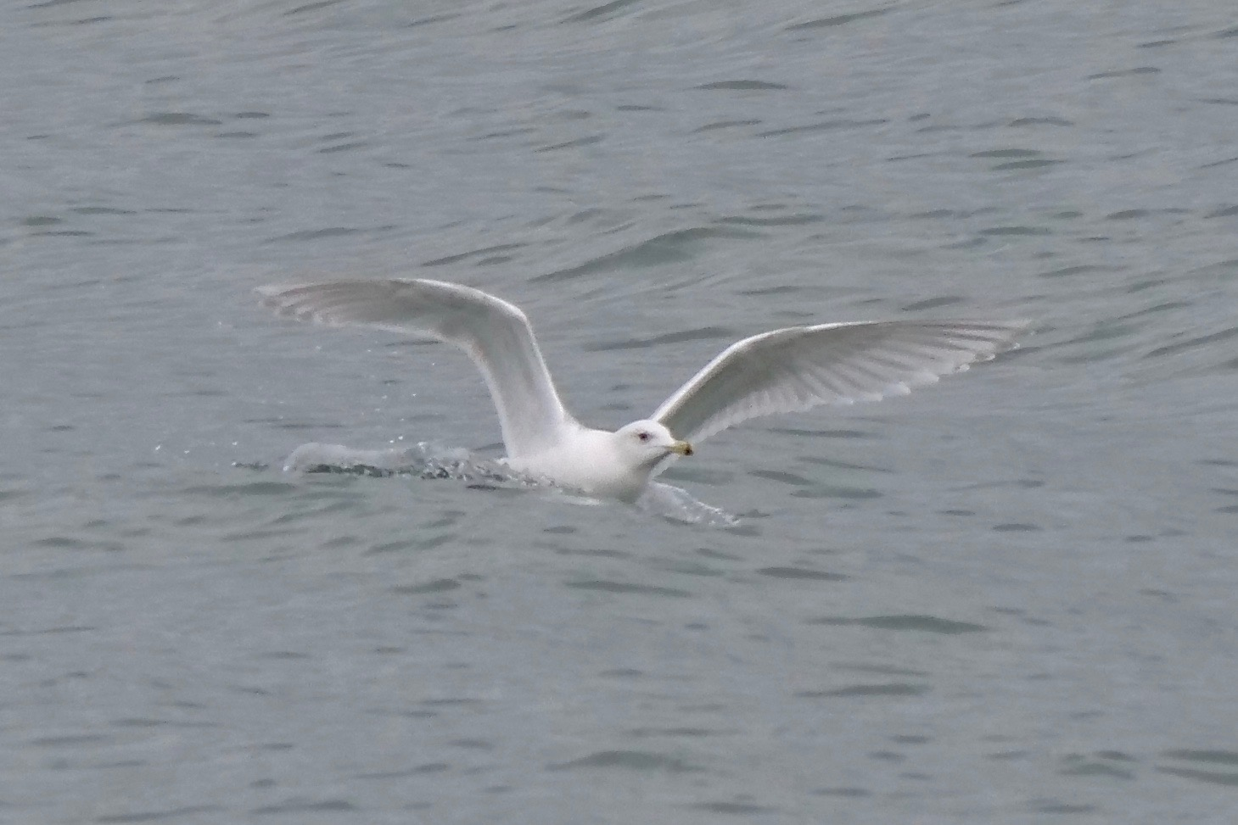
Iceland Gull (Kumlien’s)

Slide 31
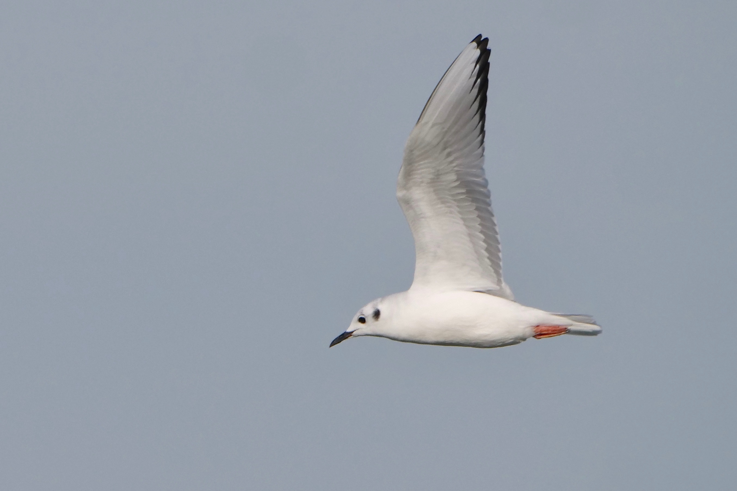
Bonaparte’s Gull

Slide 32
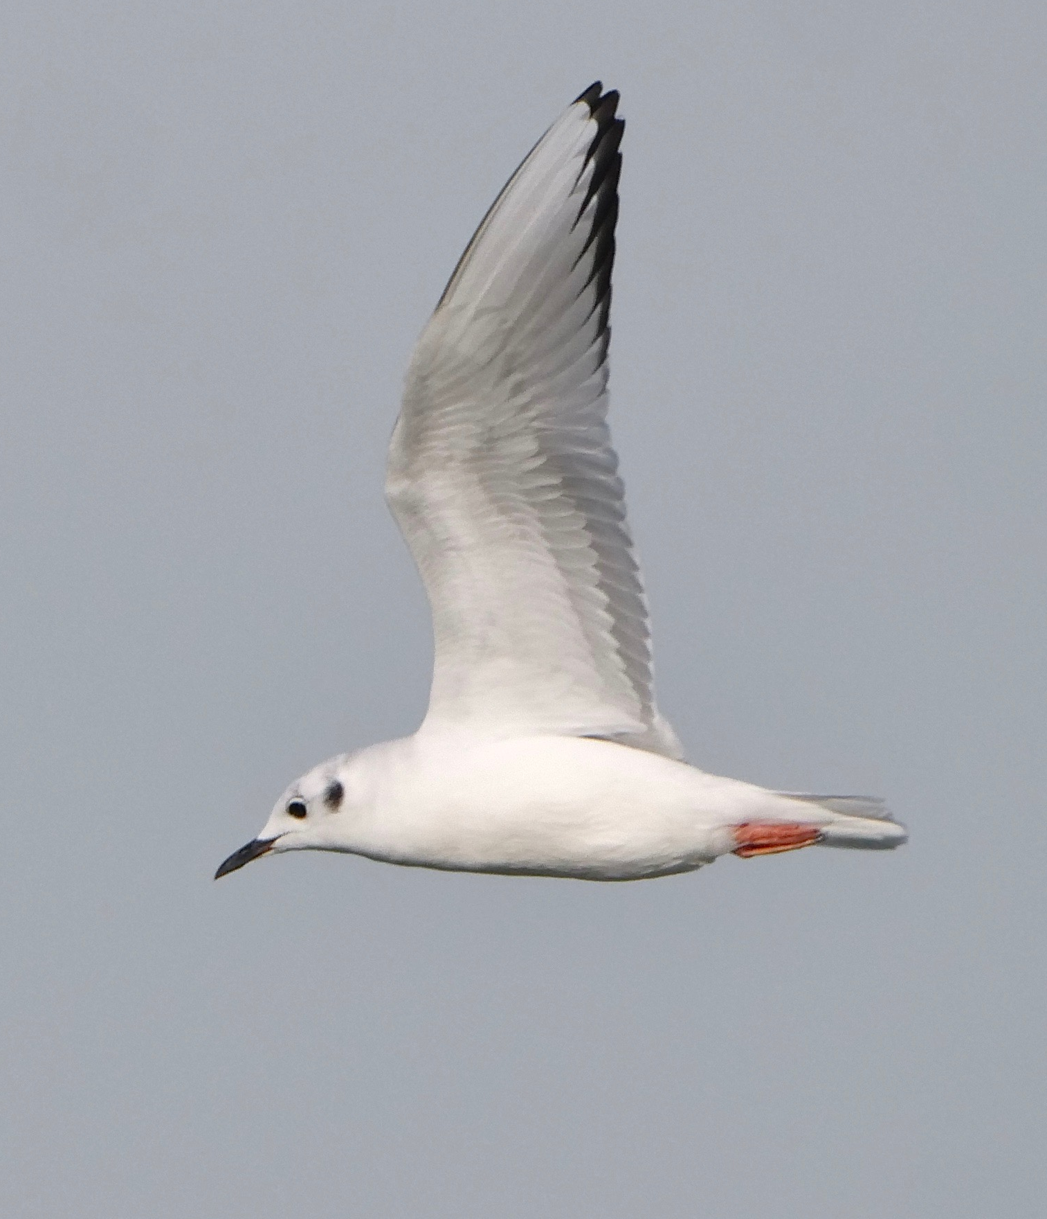

Slide 33
narrow, tern-like wings, agile and erratic flight
thin black bill
white blaze leading edge of wing on both sides

Slide 34
white blaze still prominent on leading edge of wing on both sides

Slide 35
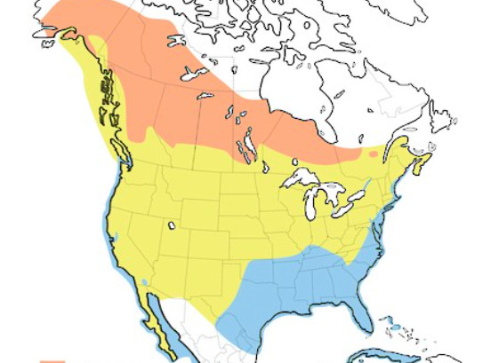
Wind conditions
earth.nullschool.net 11/17/2020
Cornell Lab of Ornithology 2021

Slide 36
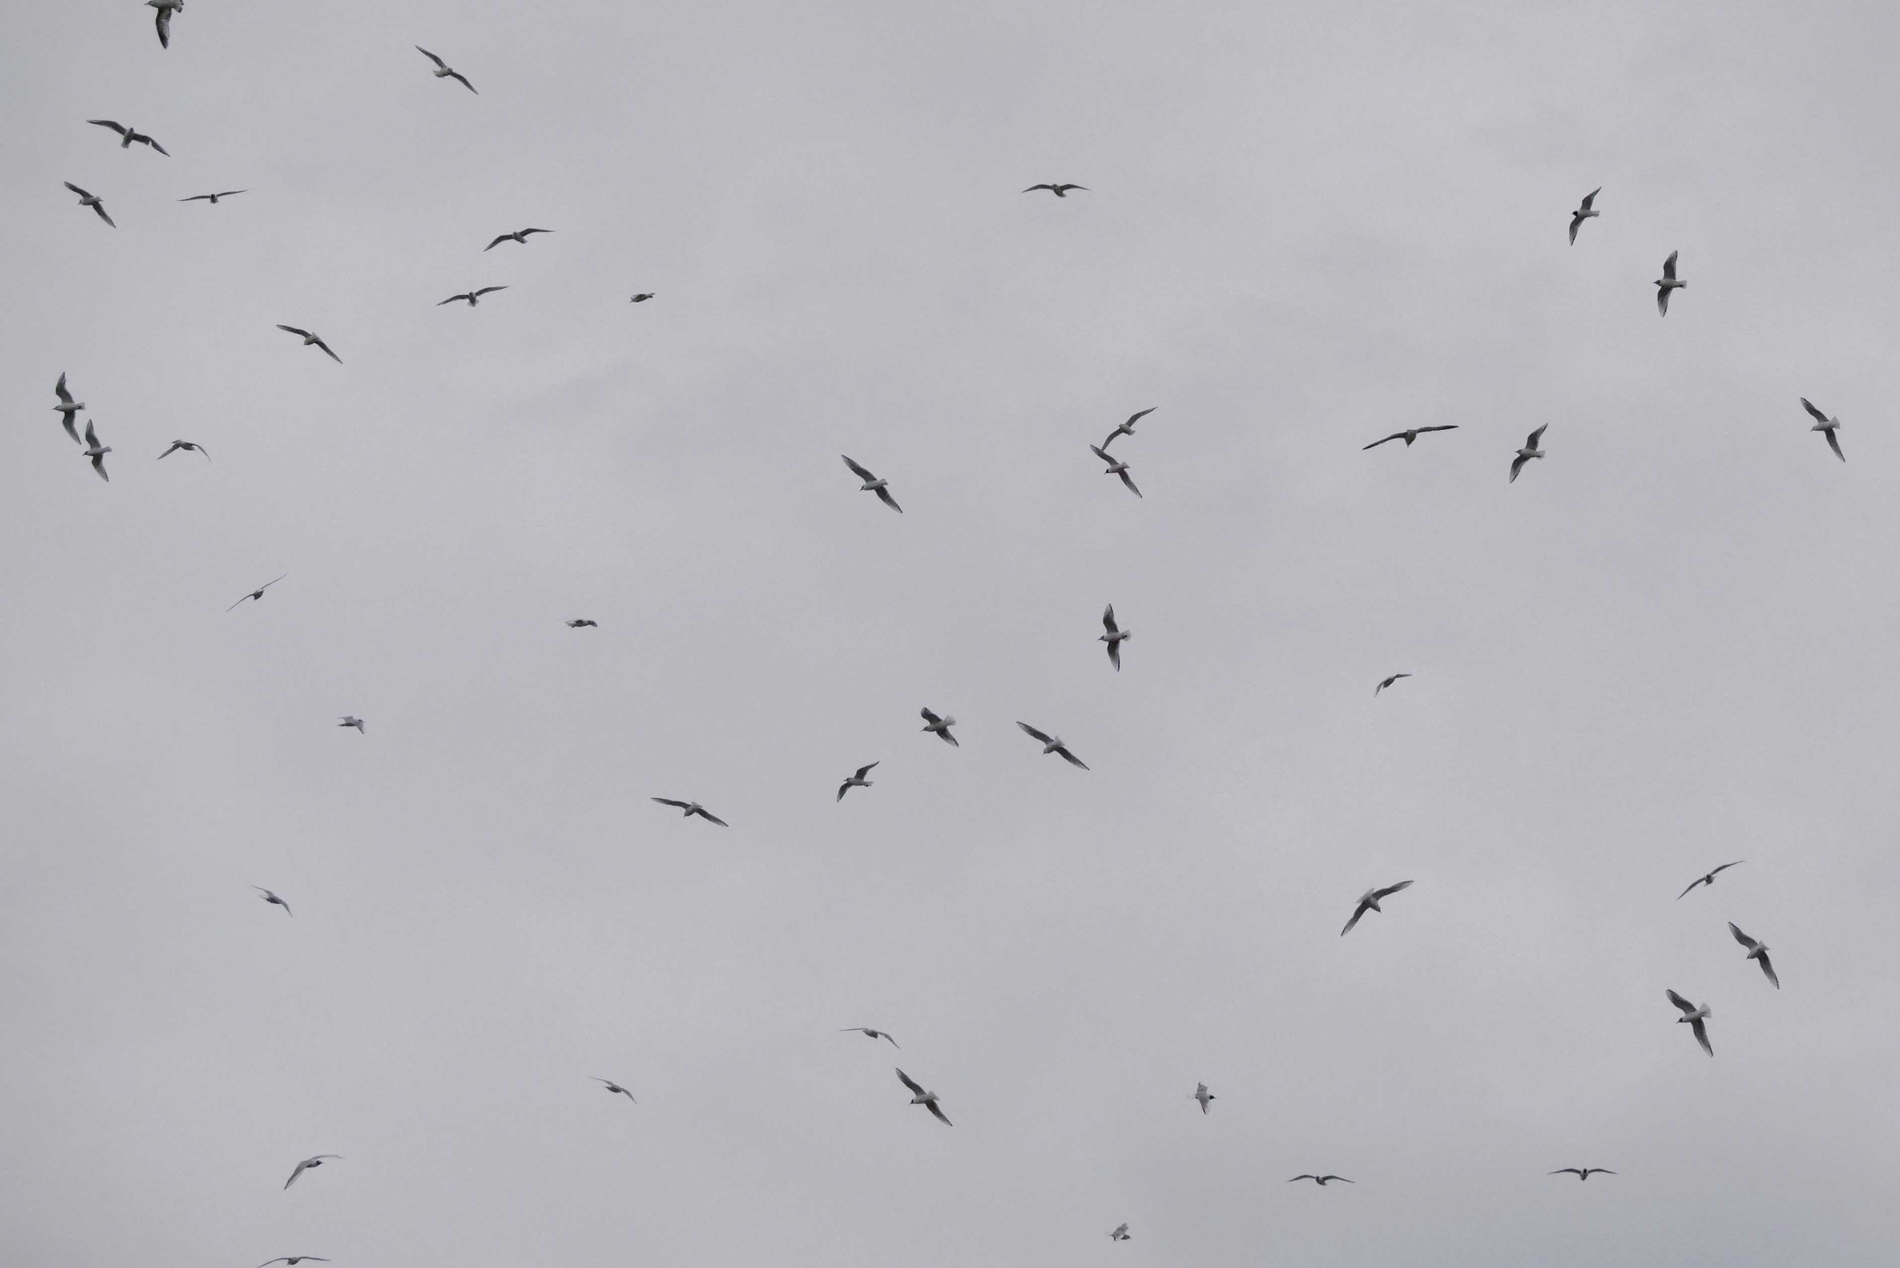

Slide 37
Franklin’s Gull (L) and Laughing Gull (R)

Slide 38
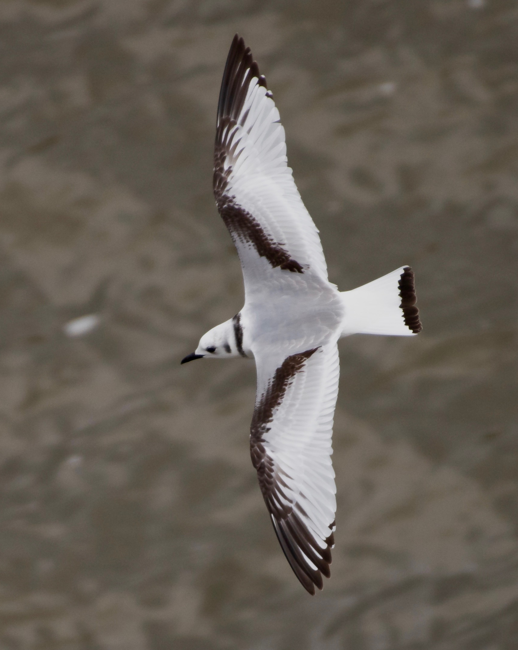
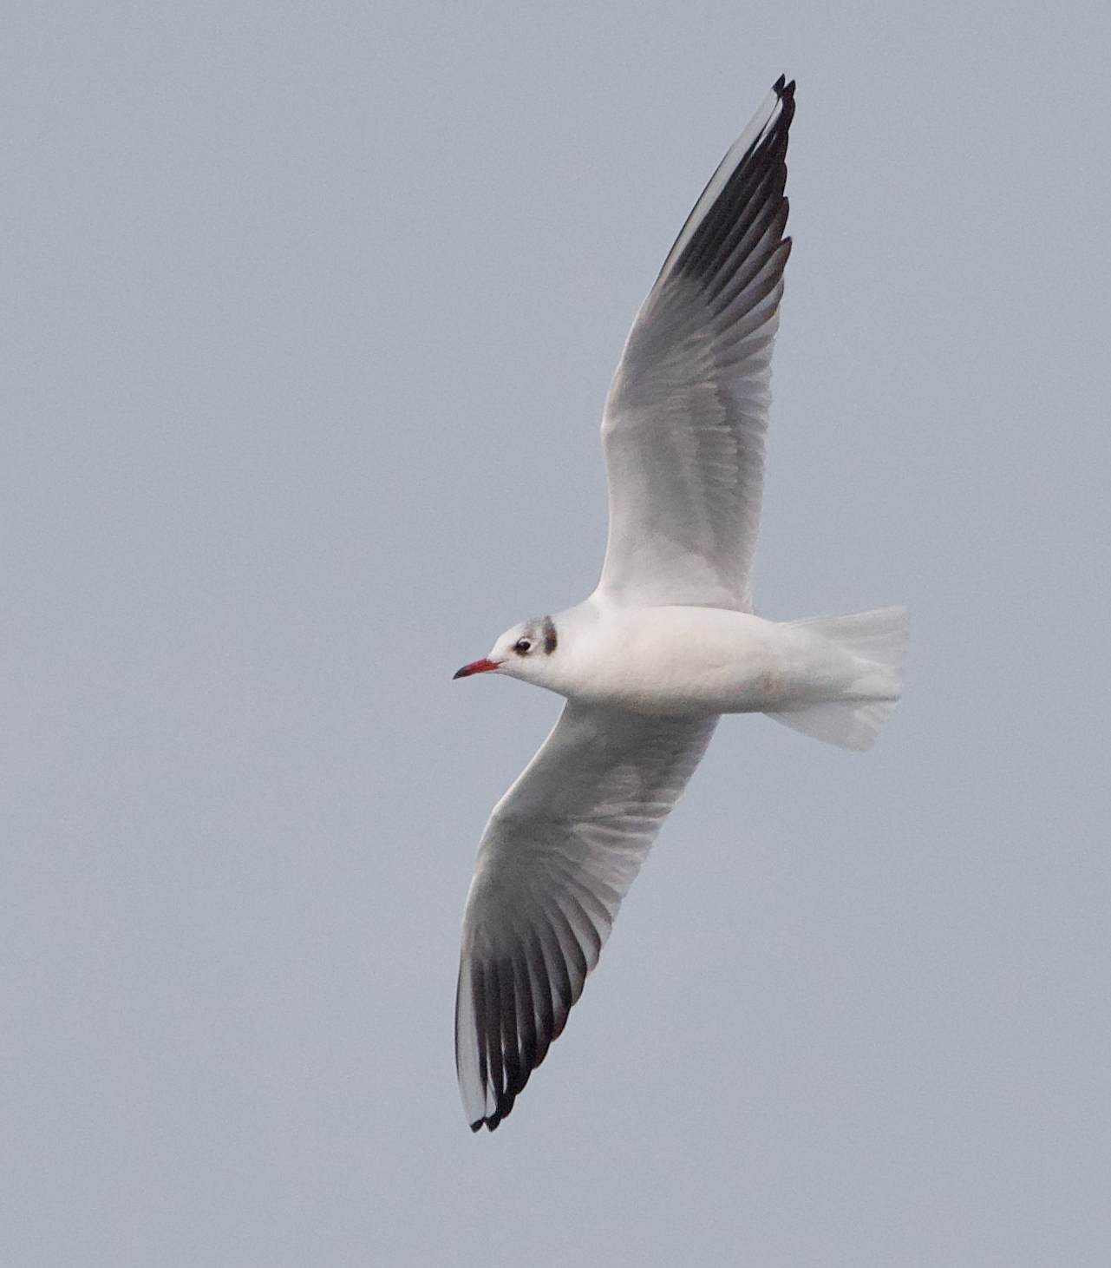
L to R: Black-legged Kittiwake, Sabine’s Gull, Black-headed Gull

Slide 39
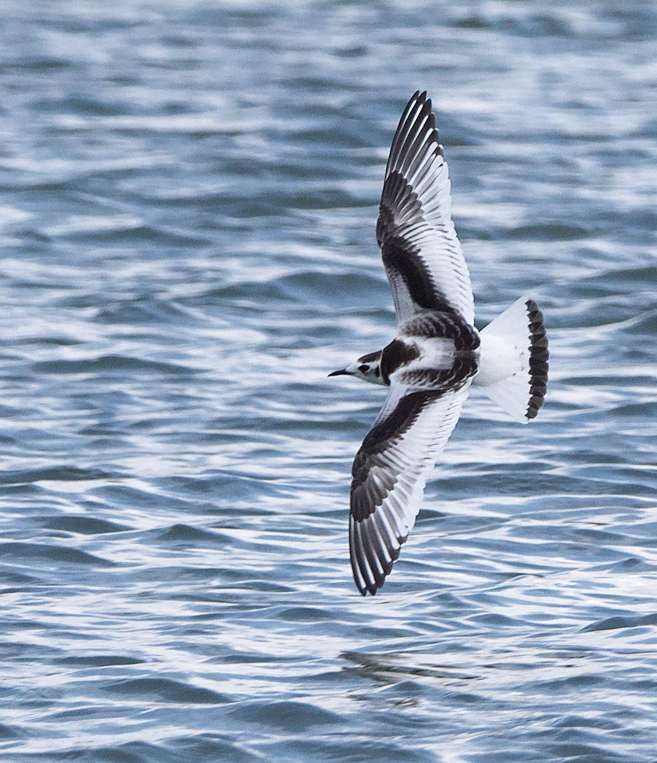
Little Gull

Slide 40
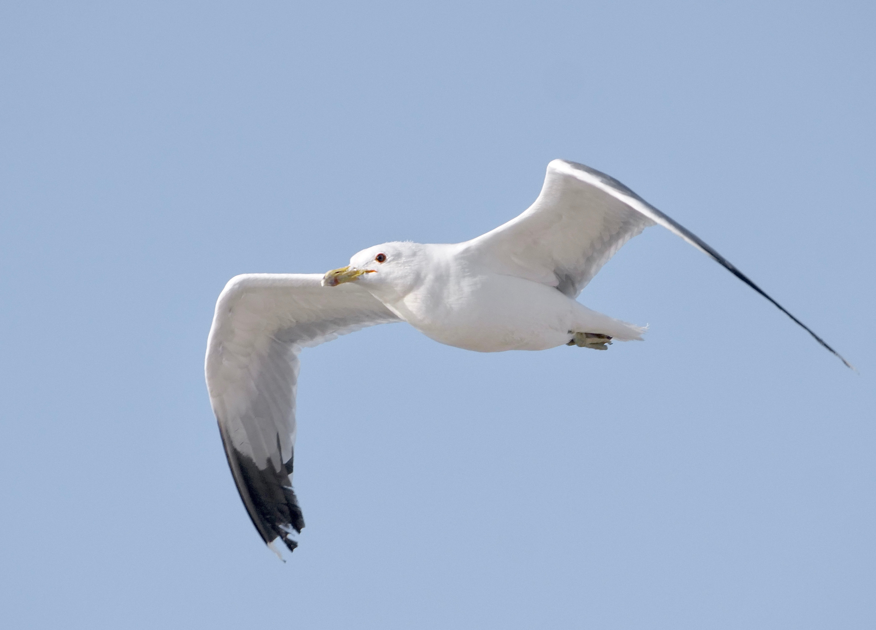
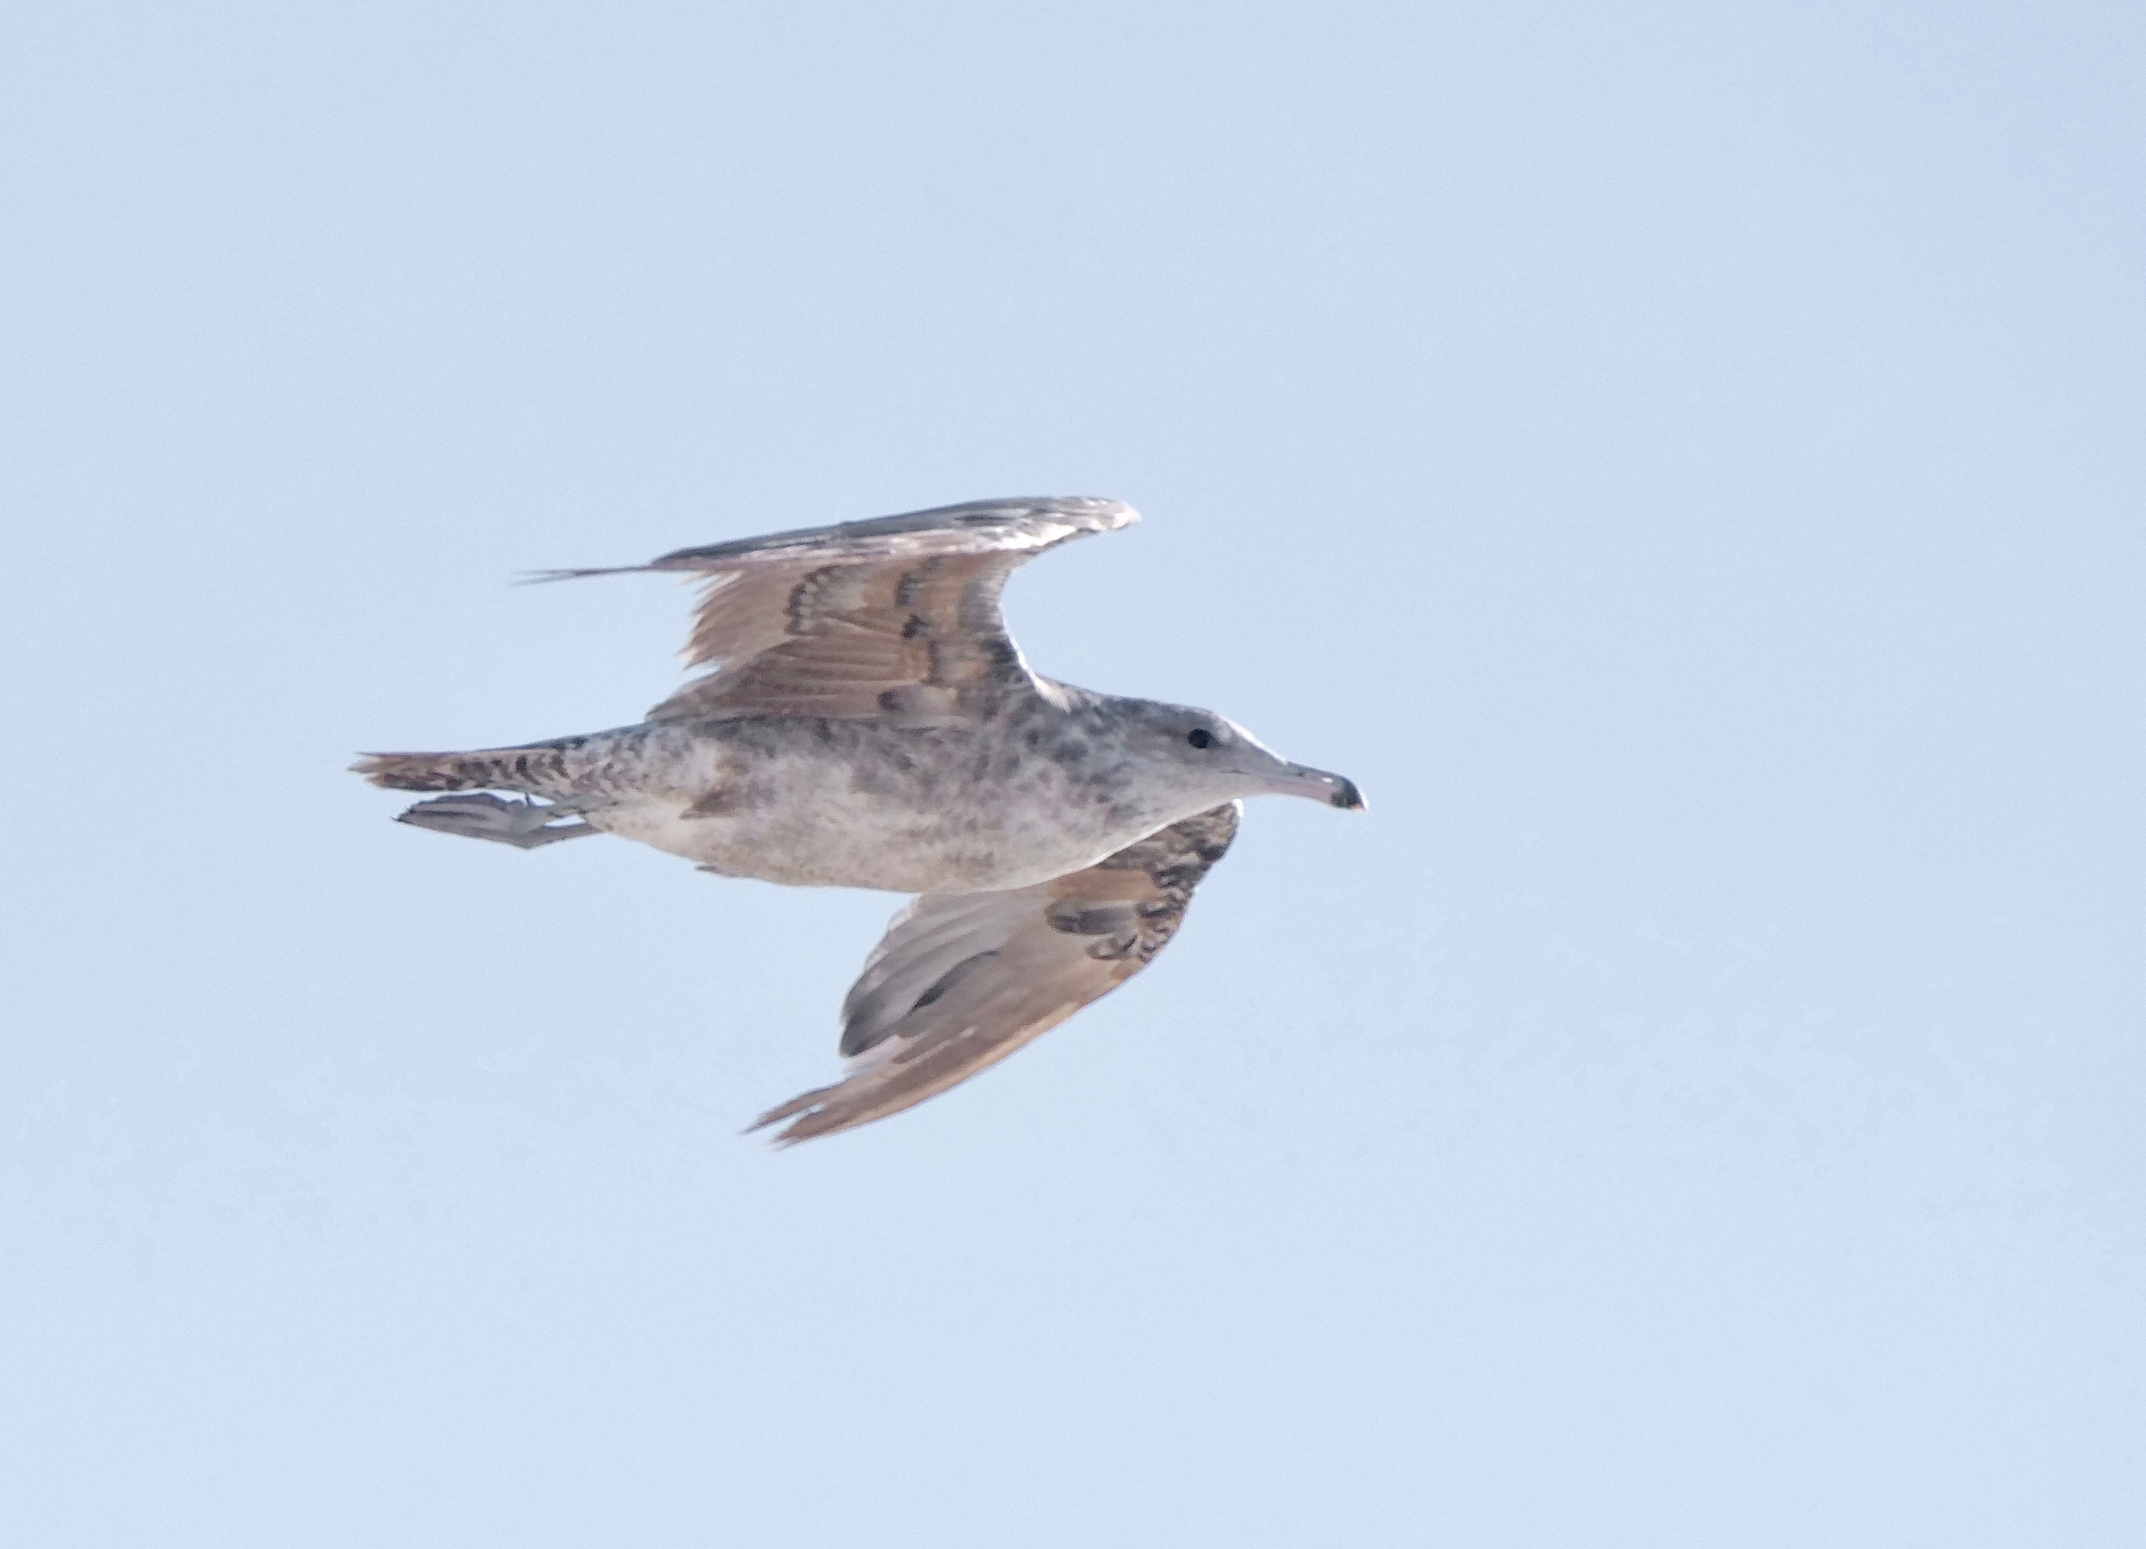
California Gull

Slide 41
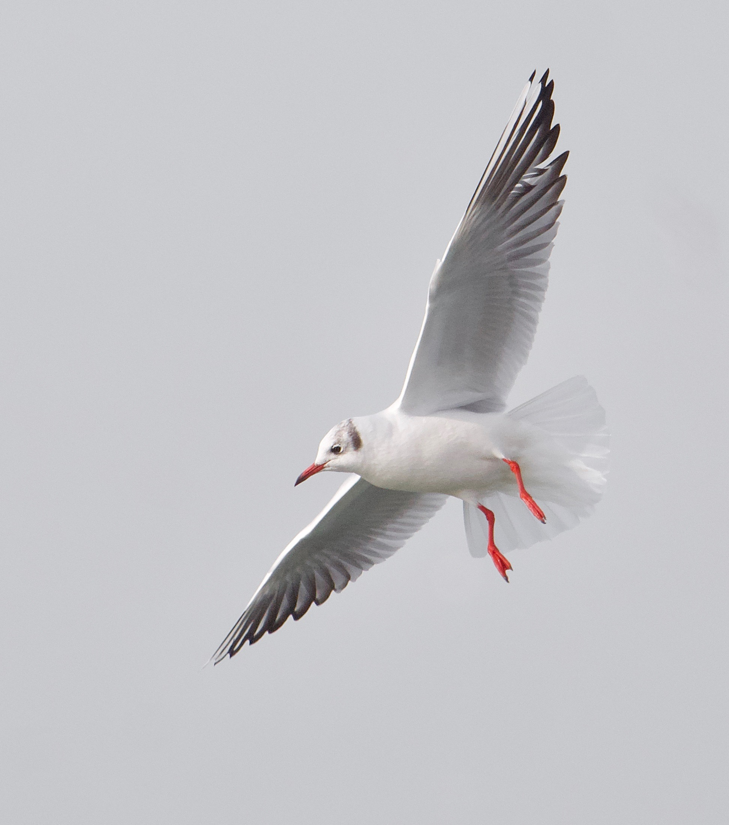
Dates of occurrence
Dec-May
- large white-wingers, western/Siberian vagrants, Black-headed Gull
May-Aug
- Laughing Gull, wandering Black-headed, California
Sep-Nov
- Little, Sabine’s, Kittiwake

Slide 42
West side hotspots
Huntington Reservation/Cahoon Park
Rocky River Park
Lakewood Park

Slide 43
East side hotspots
Euclid Beach/Wildwood Park
Euclid Park
Sims Park

Slide 44
Harbor hotspots
Upper Edgewater/Perkins Beach
Edgewater Beach
Edgewater Fishing Pier
Edgewater Marina
Whiskey Island Marina
Wendy Park/Coast Guard Station
Scranton Flats/Cuyahoga River
Port of Cleveland
East 9th St. Pier and Marina
Burke Lakefront Airport
Cleveland Public Power
E. 55th St. Marina
E. 72nd St. Marina
Gordon Marina
Cleveland Lakefront Nature Preserve

Slide 45
